Slide 1
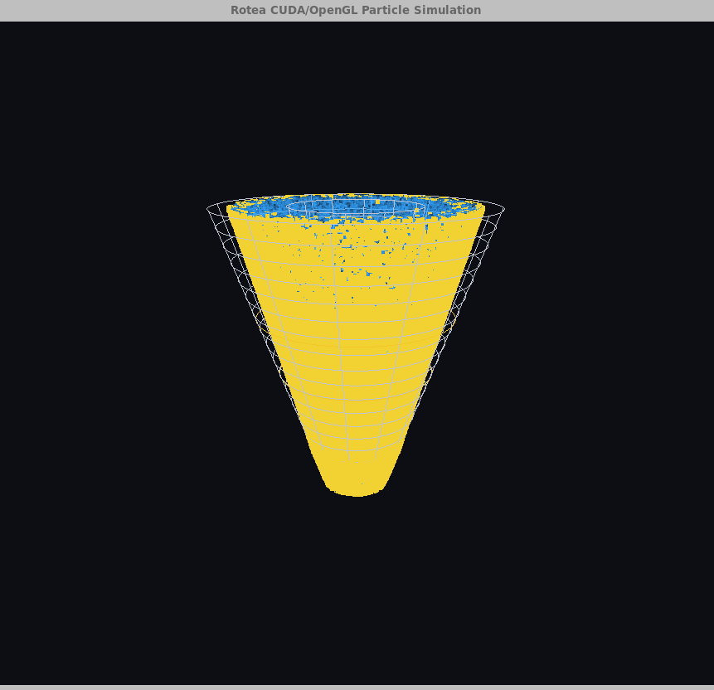
Rotea Cell Washer
GPU Simulation
CUDA/OpenGL particle model for counterflow centrifugation
Dylan Renard • EN.605.617 Introduction to GPU Programming

Slide 2
Agenda
Instrument context → model → implementation → benchmark interpretation
1
Rotea instrument and CFC protocol
2
Physics abstraction
3
CPU/CUDA/OpenGL design
4
Visual benchmark results
5
Headless benchmark results
6
Lessons learned and future work

Slide 3
Project thesis
A GPU final project should test both implementation and architecture.
3.78×
0 ms
CPU↔GPU
CFC
headless CUDA speedup at 200k particles
render time in headless benchmark
copies limit live visual CUDA mode
Rotea-inspired force model
• The visual app shows the complete interactive system, including OpenGL overhead. • The headless benchmark isolates particle-update cost and better measures CUDA usefulness. • The final lesson is not simply “GPU faster”; it is when CUDA is worth using.

Slide 4
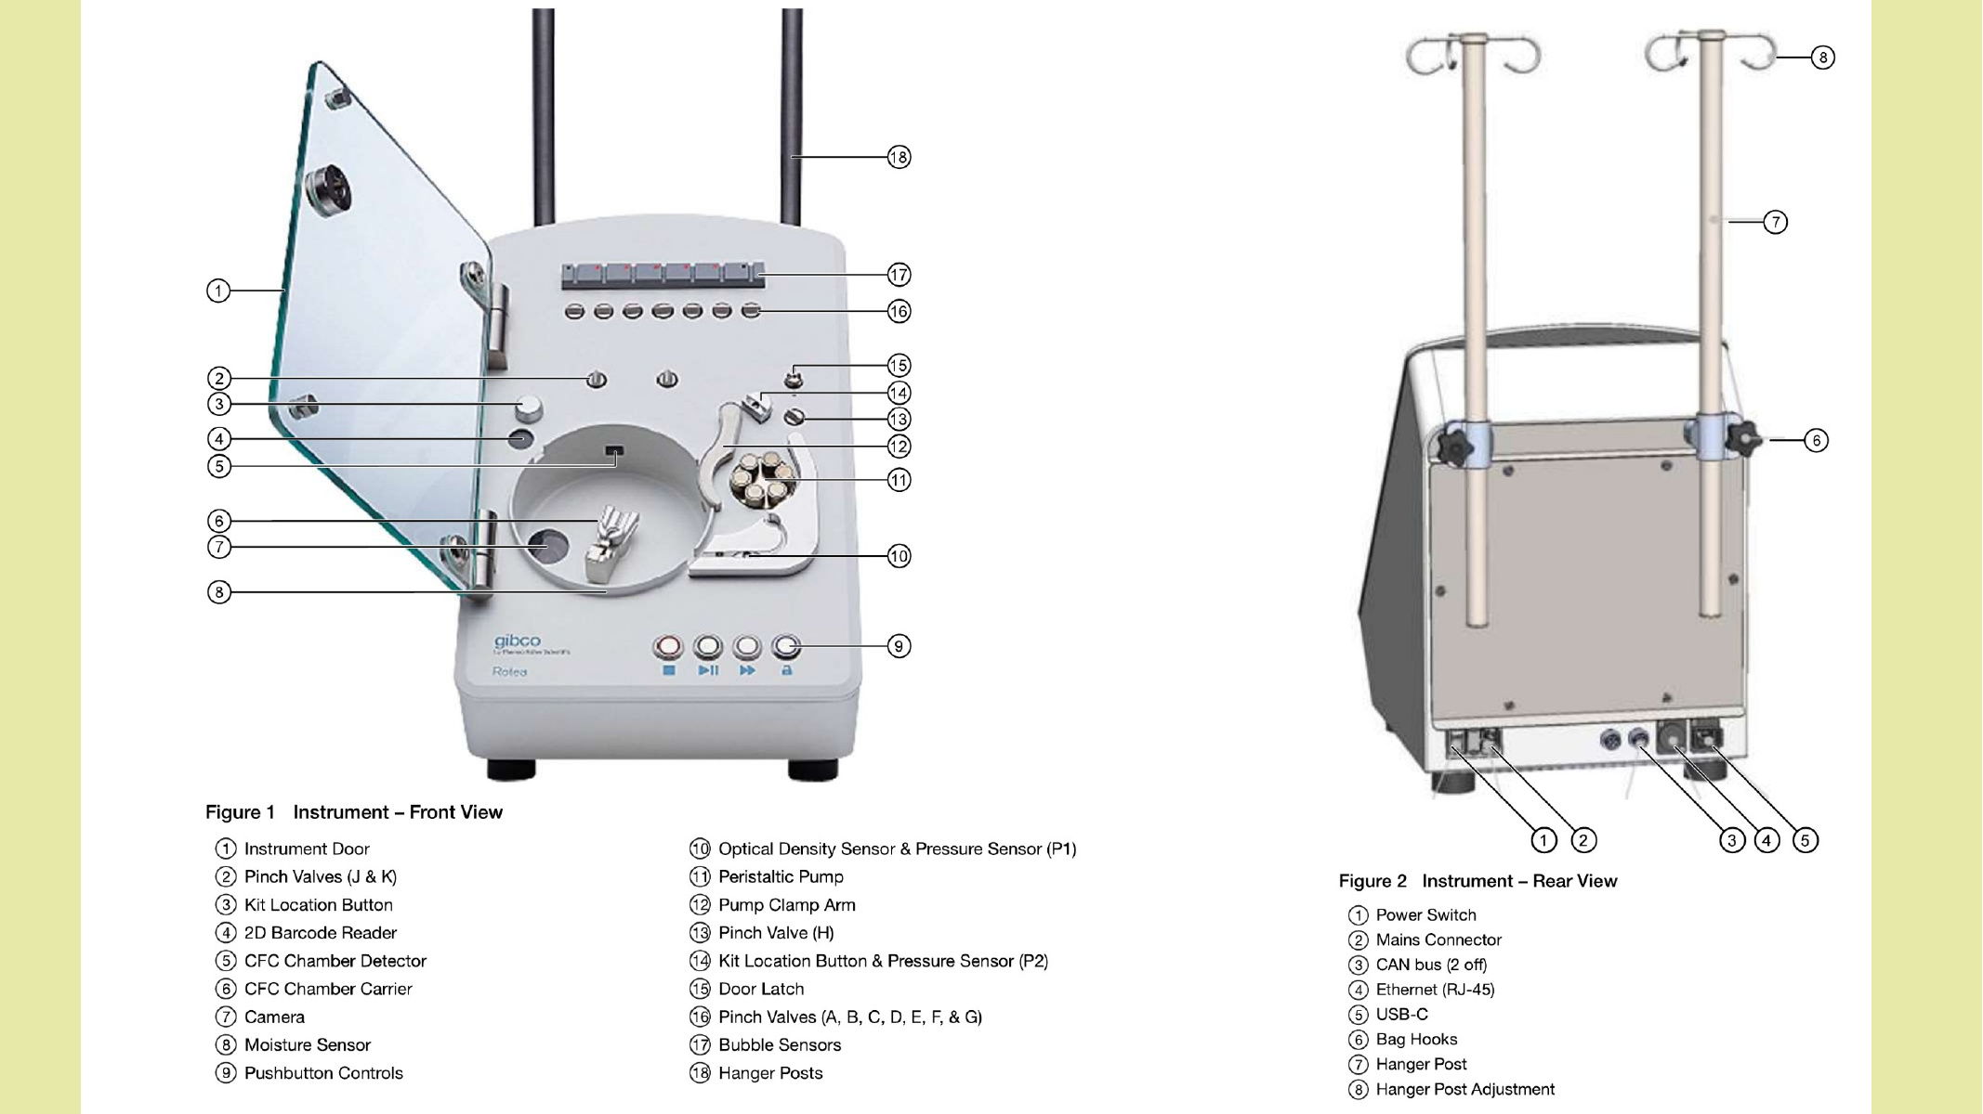
Rotea instrument reference
Front/rear instrument layout from the original context slides.

Slide 5
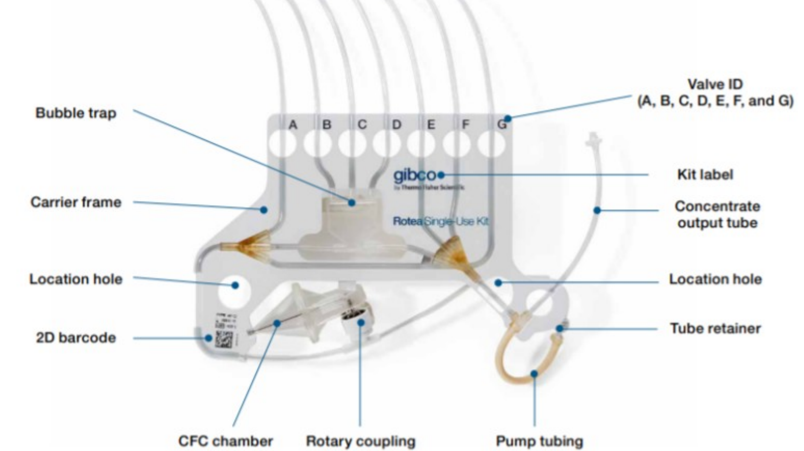
Single-use kit and CFC chamber
The modeled particle region corresponds to the CFC chamber and tubing flow path.

Slide 6
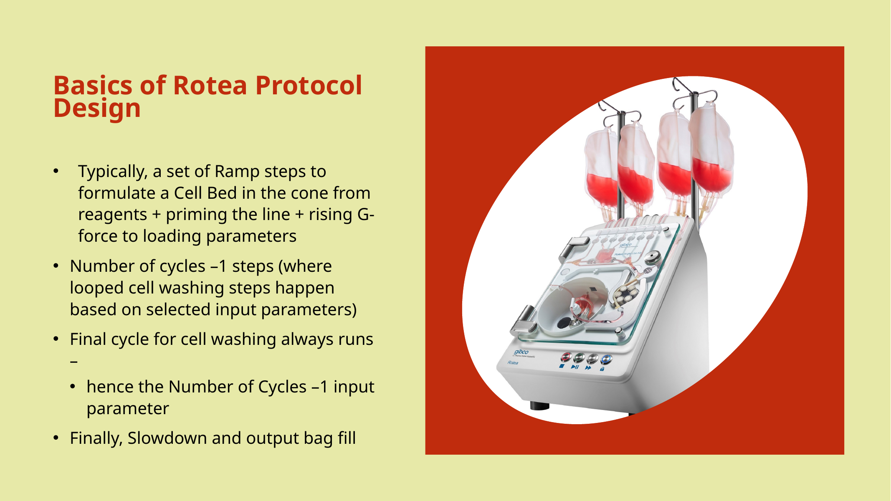
Protocol design context
Protocols cycle through loading, wash/concentration behavior, and final recovery/output.

Slide 7
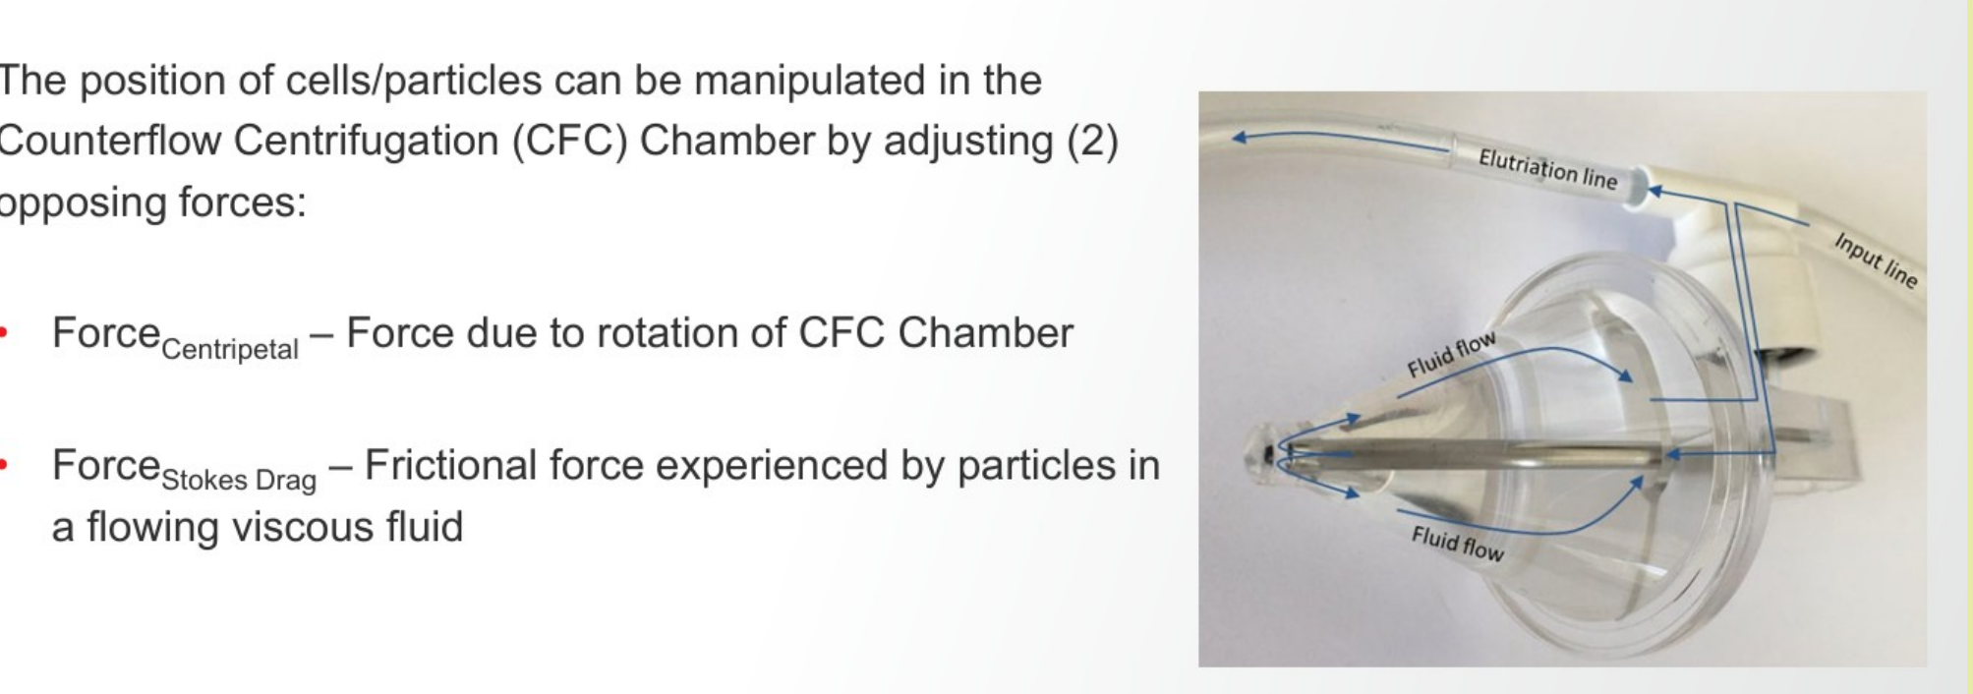
Counterflow centrifugation forces
Particle position is controlled by opposing rotation and flow forces.

Slide 8
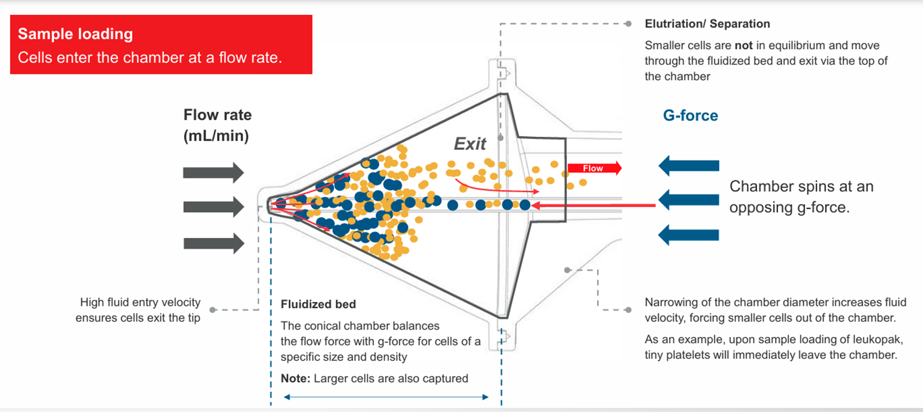
CFC interpretation used for the simulator
Larger/denser particles tend to remain in the fluidized bed; smaller/lighter particles elutriate.

Slide 9

Why make a Rotea visualization?
A simulator helps reason about process behavior before using real material.
• CFC protocols involve dynamic flow, G-force, geometry, and particle properties. • Real-world process development consumes reagents, consumables, and instrument time. • Particle simulation is embarrassingly parallel, which makes it a natural CUDA target. • The goal is qualitative scientific visualization and performance benchmarking, not validated process prediction.

Slide 10
Development design
Three core components and the key CPU/GPU distinction.
Component
File(s)
Role
Key design difference
Rendering
renderer.cpp / renderer.h
Draws conical chamber and particles with OpenGL.
Shared by CPU and CUDA; visual runtime includes render, swap, and polling overhead.
CPU implementation
sim_cpu.cpp / sim_cpu.h
Updates process state and particle motion on CPU.
Directly updates host-side particle vector; simple and reliable baseline.
GPU implementation
simulation.cu / simulation.h
Updates particles with one logical CUDA thread per particle.
Parallel update, but live visual mode copies CPU→GPU→CPU so OpenGL can render.

Slide 11
Runtime modes
The same project supports demo, benchmarking, and offline replay workflows.
Mode
Command idea
What it measures / demonstrates
Visual CPU
--mode cpu --duration
Full OpenGL application with CPU particle updates.
Visual CUDA
--mode cuda --duration
Full OpenGL application with live CUDA update path.
Headless CPU/CUDA
--headless --steps
Update loop only; no OpenGL window or rendering.
Replay
--mode replay --replay frames.bin
Visualizes precomputed frames from CUDA frame generator.
• Visual mode answers: how fast is the full interactive application? • Headless mode answers: how fast is the particle update without rendering?

Slide 12
Live CUDA data path
The implementation is correct, but the visual architecture still pays transfer/sync cost.
Host
Particles
H2D
copy
CUDA kernel
grid-stride loop
sync
D2H
copy
OpenGL
render
Screen
• The CUDA kernel uses one logical thread per particle with a grid-stride loop. • A persistent device buffer avoids cudaMalloc/cudaFree every frame. • Live visual CUDA mode still copies particles back to CPU because OpenGL consumes host-side data. • Future CUDA/OpenGL interop would let CUDA update an OpenGL buffer directly.

Slide 13
Benchmark design
Two benchmark modes were needed because they answer different questions.
Synchronous visual benchmark
Headless update benchmark
• Simulation update • CUDA transfer and synchronization • OpenGL render, swap, and event polling • Best for user-visible application behavior
• Fixed number of update steps • No OpenGL window • Render time effectively zero • Best for CPU-vs-CUDA update comparison

Slide 14
Visual benchmark results
Full interactive application: update + transfer/sync + render/swap/poll.

Slide 15
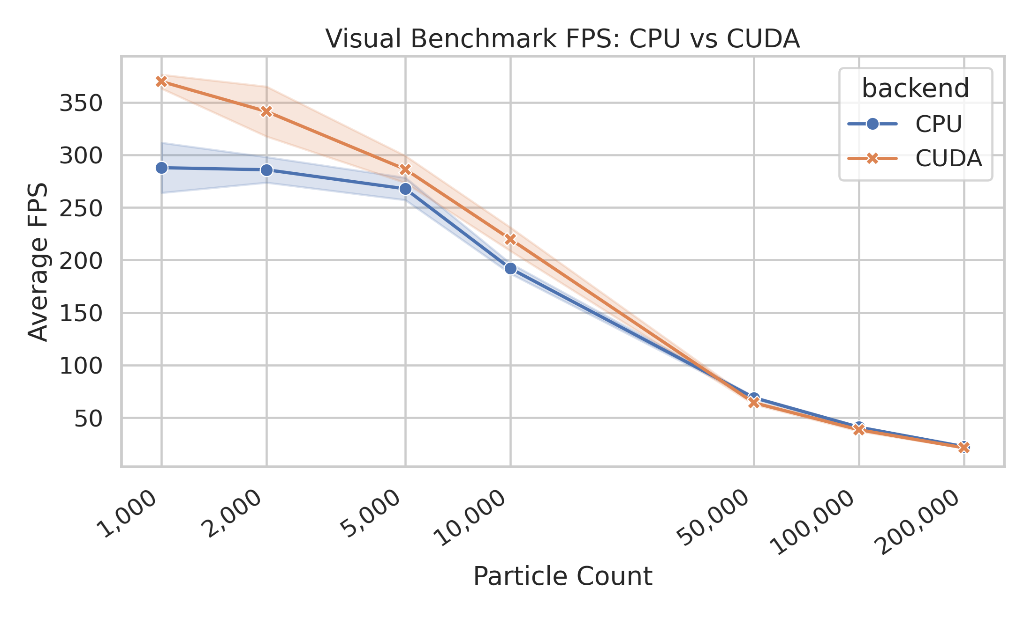
Visual FPS: CPU vs CUDA
CUDA was slightly faster at smaller counts, but end-to-end benefit shrank as rendering dominated.
• Visual FPS falls as particle count increases. • CUDA does not guarantee a large end-to-end speedup because the visual app includes rendering and synchronization. • At high counts, both paths are constrained by the full application loop.

Slide 16
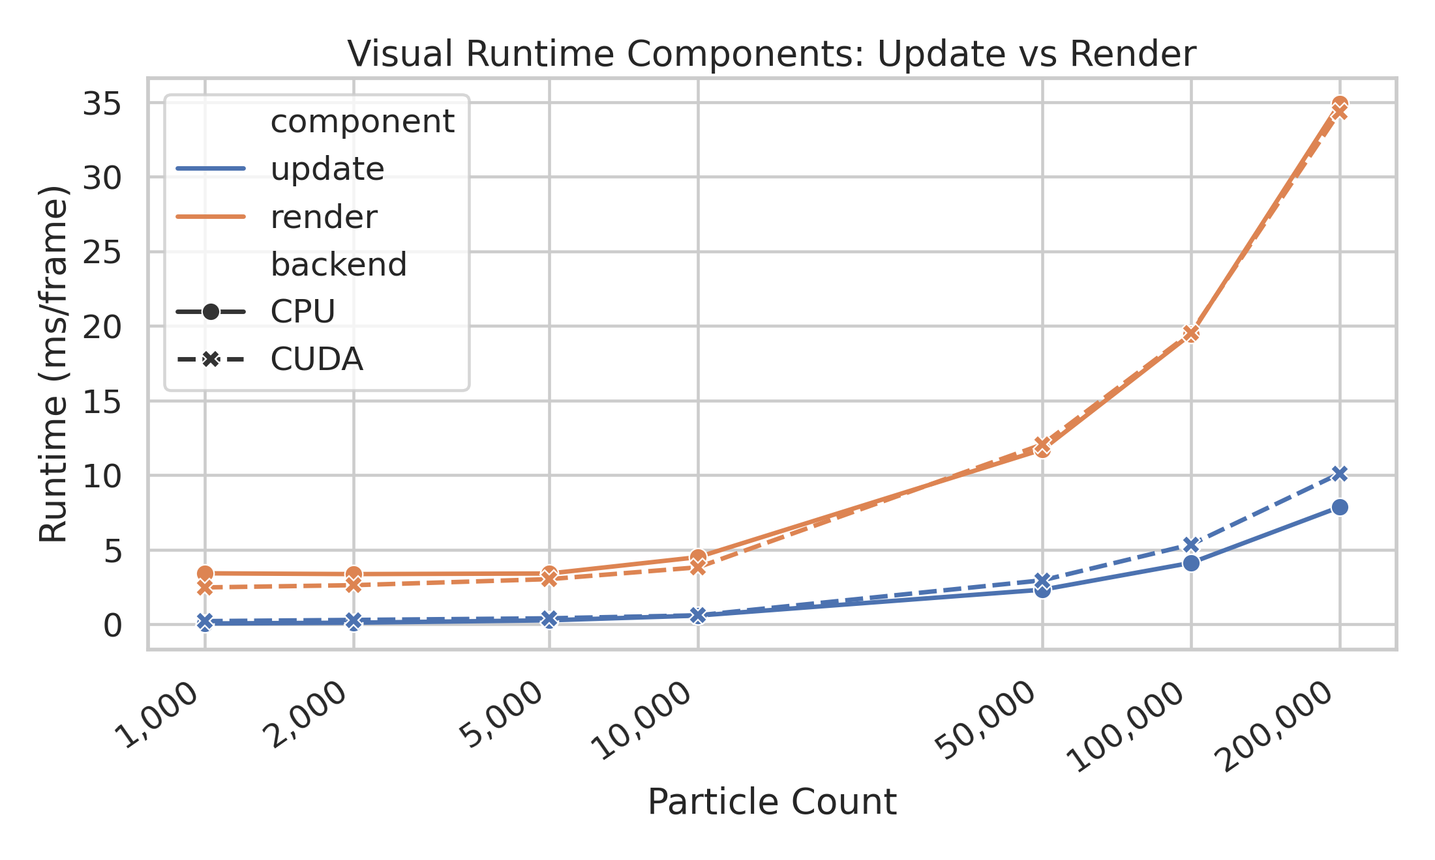
Visual runtime components
Rendering becomes a major contributor to frame cost as particle count increases.

Slide 17
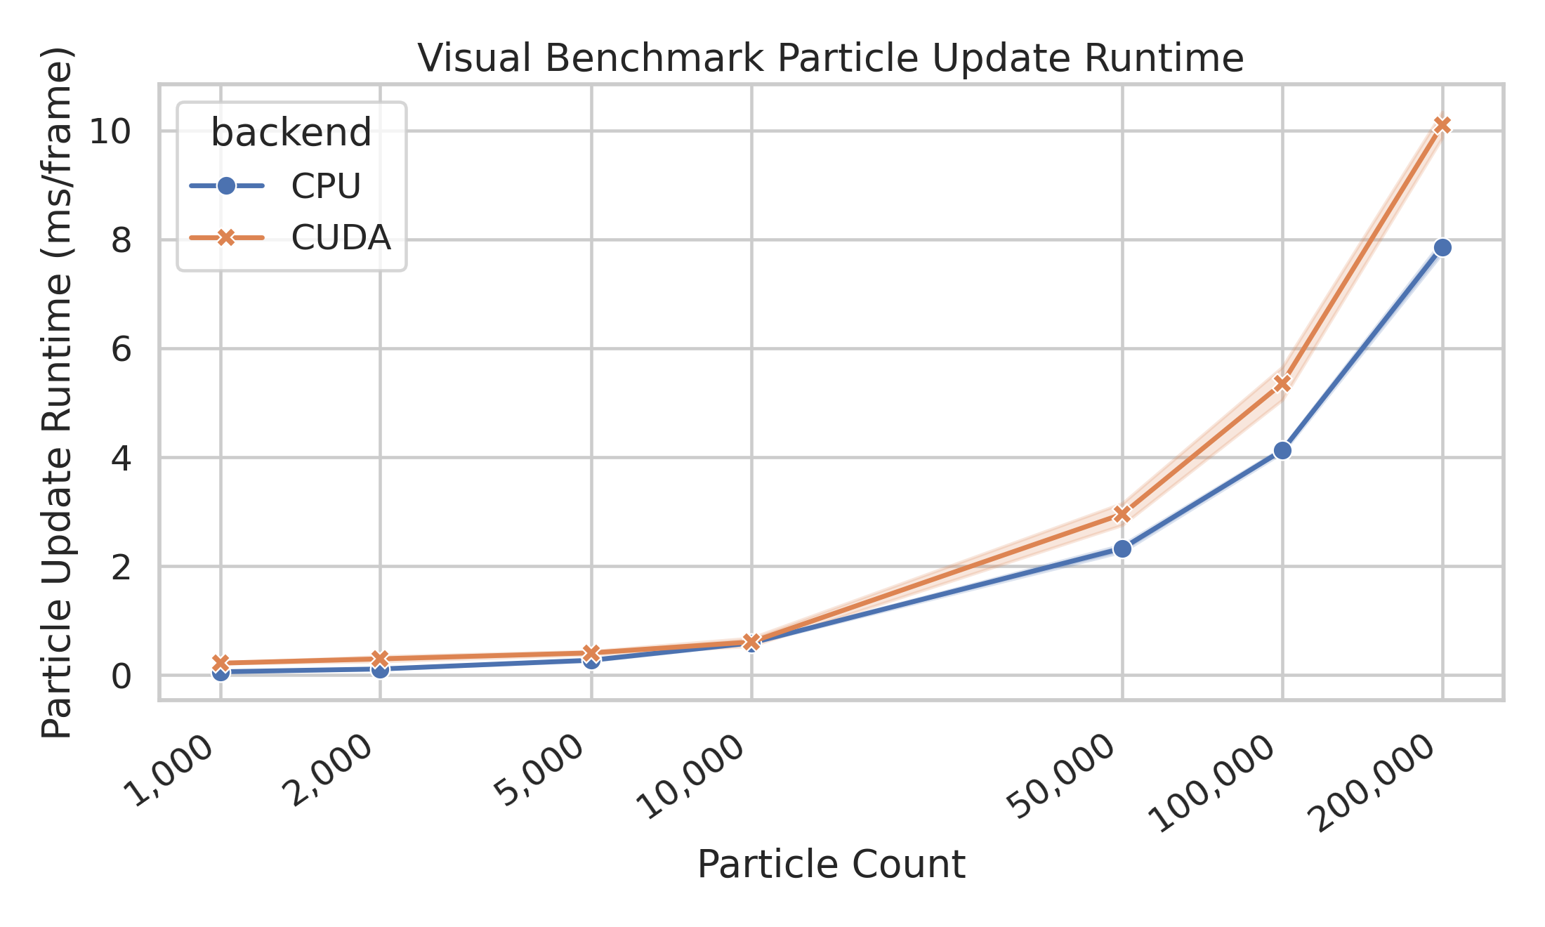
Visual particle update runtime
Live CUDA update includes transfer, kernel launch, synchronization, and copy-back.
• The visual CUDA particle update is not a pure kernel timing. • The H2D/D2H copies are required because the renderer consumes host-side particles. • This explains why visual CUDA can trail the CPU at larger counts.

Slide 18
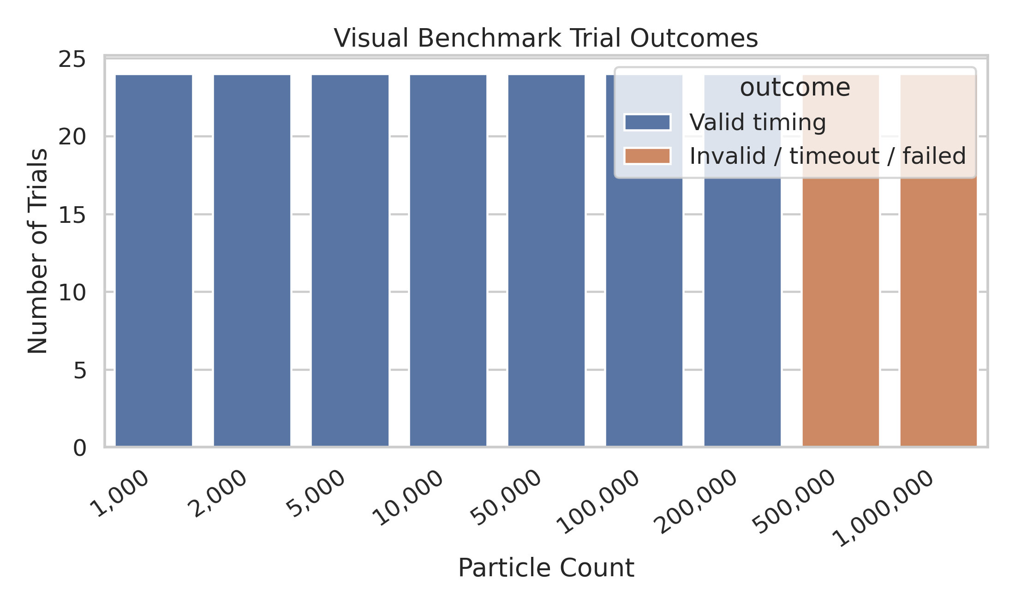
Visual stress-test outcomes
The largest visual runs were treated as timing-harness failures rather than valid quantitative timing.
• Runs through 200k particles produced valid timing results. • 500k and 1M visual runs exceeded the practical timing harness limits. • These rows are useful stress-test evidence, but not used as quantitative speedup claims.

Slide 19
Headless benchmark results
OpenGL disabled: update-loop cost is isolated from rendering.

Slide 20
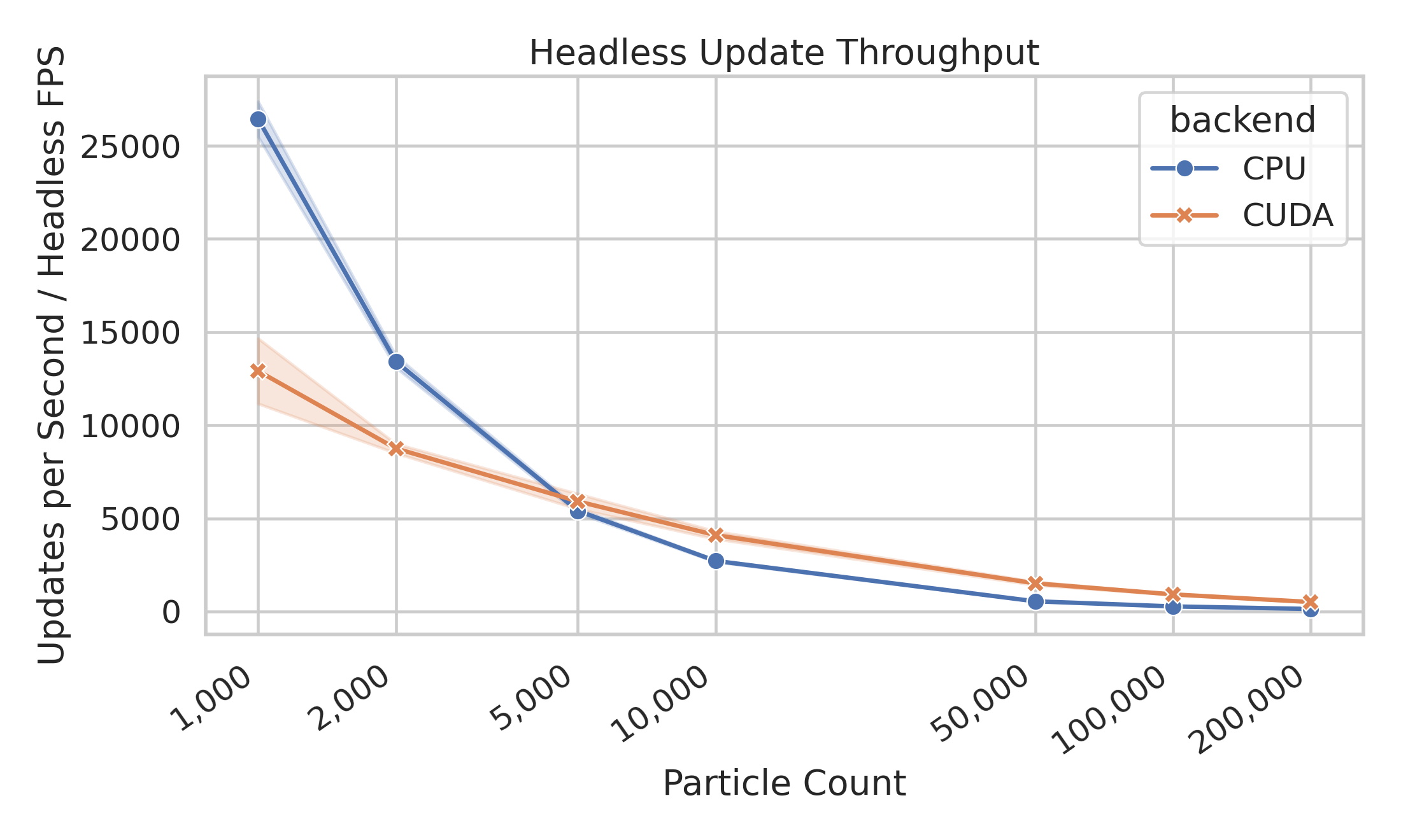
Headless throughput
CPU wins tiny workloads; CUDA becomes favorable once particle count is large enough.
• At small particle counts, CPU avoids GPU launch/transfer overhead. • CUDA throughput becomes better as work per step increases. • This benchmark supports the main performance conclusion.

Slide 21
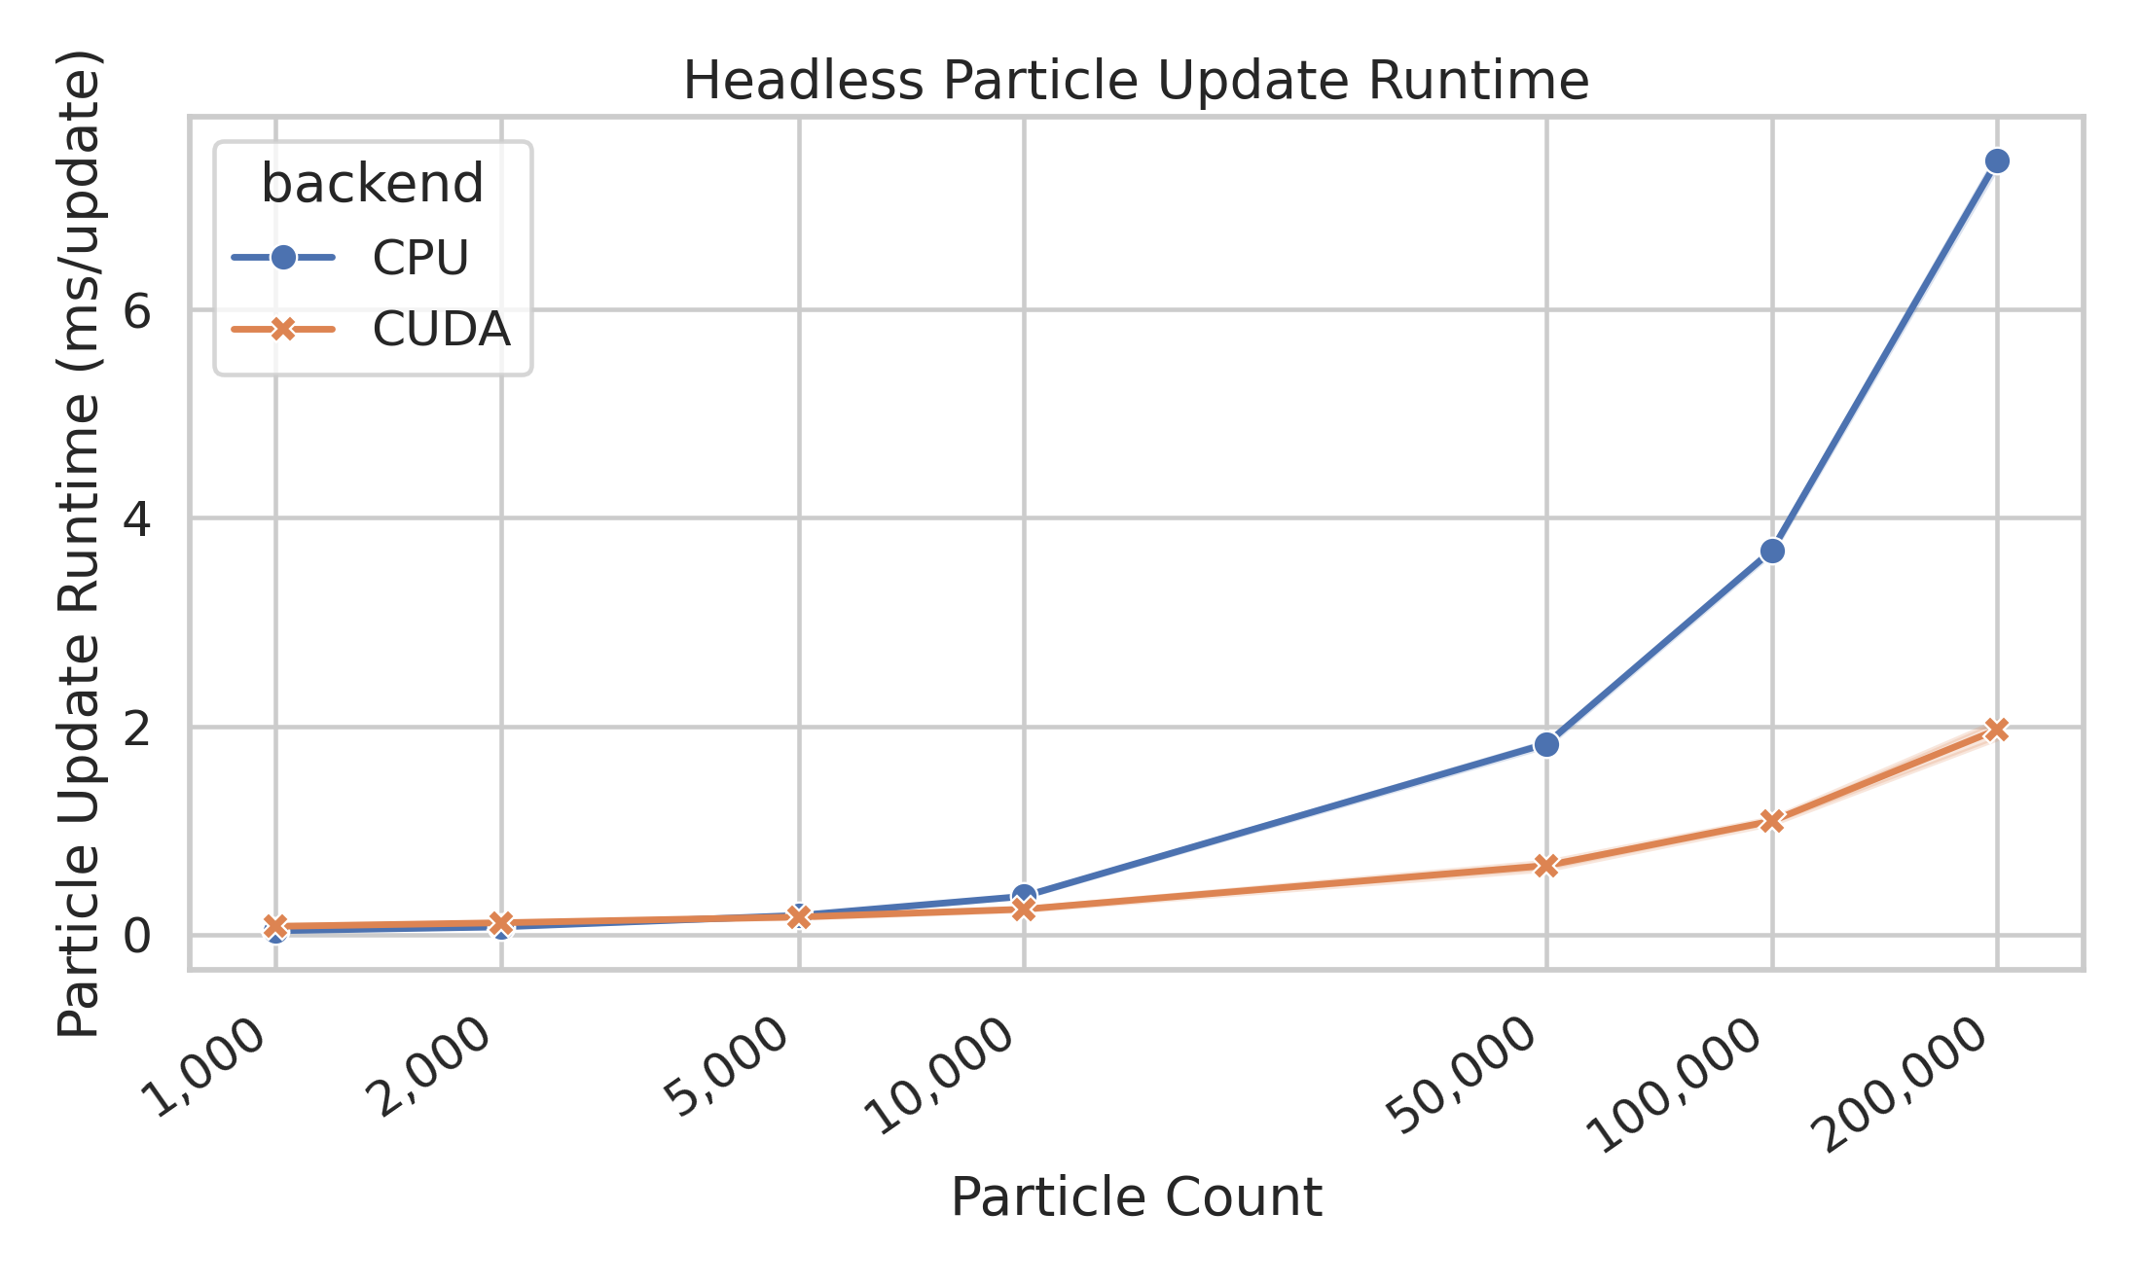
Headless particle-update runtime
The isolated update loop shows the CUDA scaling advantage clearly.
7.427 ms
CPU update at 200k particles
1.967 ms
CUDA update at 200k particles
3.78×
CUDA speedup at 200k particles

Slide 22
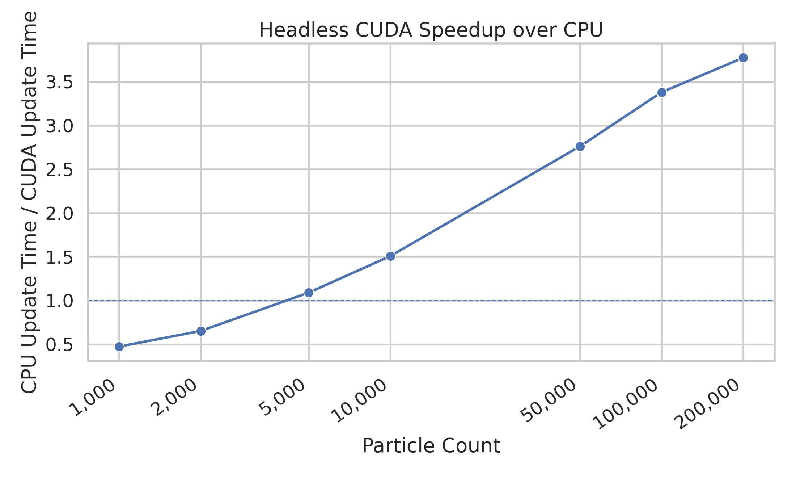
Headless CUDA speedup
The crossover occurs after the workload is large enough to overcome GPU overhead.
• Below the crossover, CPU overhead is lower. • Above the crossover, particle-level parallelism increasingly favors CUDA. • This is the most important project result.

Slide 23
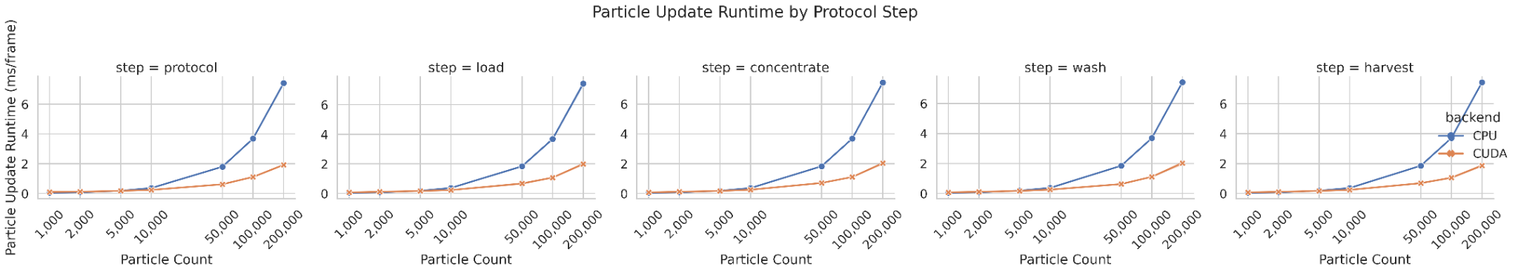
Headless update runtime by protocol step
CUDA scaling advantage was consistent across load, concentrate, wash, harvest, and protocol runs.

Slide 24
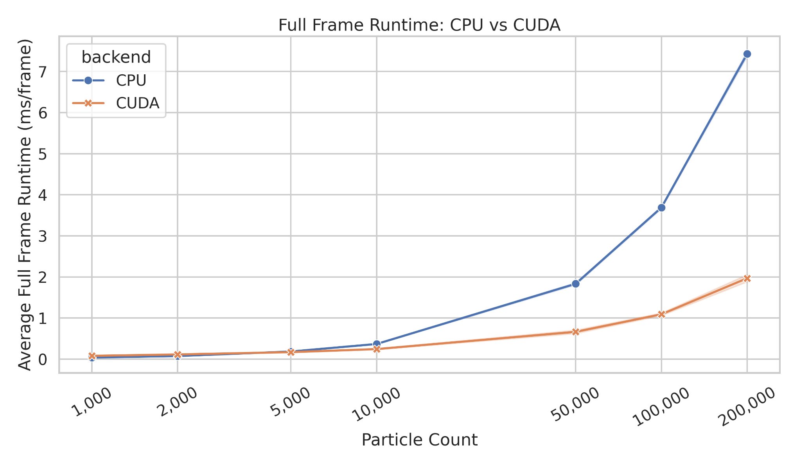
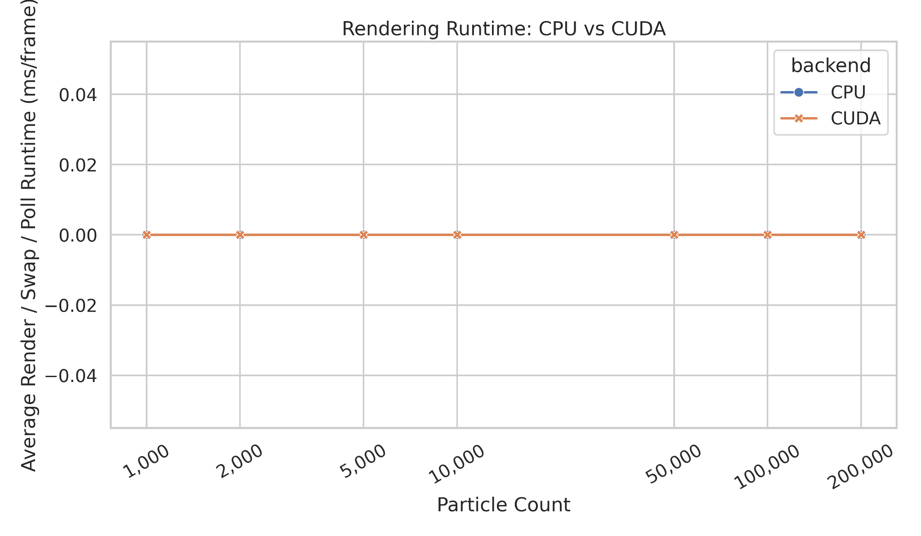
Headless sanity check
Render/swap/poll time is eliminated in headless mode.
Headless full-frame time is effectively update-loop time; render runtime is 0 ms/frame.

Slide 25
What the results mean
The answer depends on what was measured.
Question
Best benchmark
Conclusion
How fast is the full interactive app?
Visual benchmark
CUDA helped only modestly because rendering and CPU/GPU coordination remained in the loop.
How fast is the particle update itself?
Headless benchmark
CUDA became increasingly favorable at larger particle counts.
Was CUDA worth using here?
Both together
Yes for high-count update workloads; less so if data movement and rendering dominate.

Slide 26
Limitations
The project is a GPU simulation and visualization tool, not a validated process-development model.
• Simulation uses normalized units rather than calibrated SI units. • The fluid field is approximated rather than solved with CFD. • No experimental validation against bead/cell Rotea runs was performed. • Live CUDA mode still copies particles between CPU and GPU each frame. • CUDA/OpenGL interoperability was identified but not implemented.

Slide 27
Future work
The next best improvement is architectural, not just another kernel tweak.
• Use CUDA/OpenGL interoperability so CUDA updates an OpenGL vertex buffer directly. • Move from array-of-structures to structure-of-arrays for better coalescing. • Add CUDA event timing to live mode for finer performance measurement. • Calibrate geometry, flow, and angular velocity with real physical units. • Compare simulation outputs against bead or cell-processing runs.
Current: CPU particles → GPU update → CPU copy-back → OpenGL render | Future: CUDA updates GPU-resident OpenGL buffer directly

Slide 28
Final lesson
CUDA is not automatically faster — architecture decides whether parallelism becomes performance.
• The visual benchmark showed why end-to-end speedup can be limited by rendering, transfer, and synchronization. • The headless benchmark showed that the CUDA particle update scales better once the workload is large enough. • The practical lesson is knowing when to use CUDA, and when data movement or application structure will hide the benefit.
Know when to use CUDA — and when not to.

Slide 29
Thank You
Rotea-inspired CUDA/OpenGL particle simulation
Dylan Renard

